Slide 1
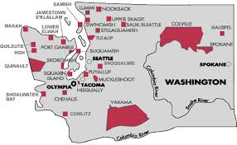
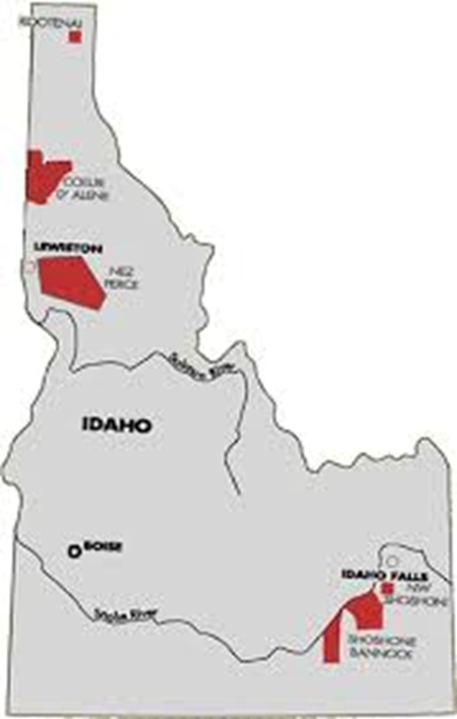
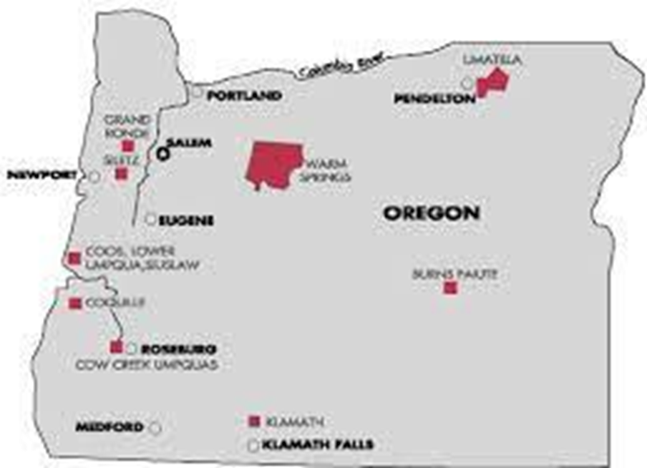

Slide 2
NwONAP Staff Updates
Tom Carney
Administrator
Kirsten Franklin- Temple
Administrator Advisor
GRANTS MANAGEMENT
David Boyd – Director
Sandel Ferguson – Team Lead
Shakoe English
Maya Urban
Clint Zarnosky
Joe Anderson
Mandy Ewing
Mayen Akpan
Linda Brenner
Christopher Camacho
Kevin O’Connor – COVID Focused
GRANTS EVALUATION
Greg Roe – Director
Katie Wilson – Team Lead
Melanie Fisher
Aaron Gerrard
Linda O’Rourke
Marty McCormick
Niki Paganucci
Leslie Jackson
Angelique Adams
Tira McIntosh-Lampkins (5/20/24

Slide 3
Pandemic Funding
NwONAP Cumulative Spending
Funding Source | % disbursed
IHBG ARP | 54%
ICDBG ARP | 64%
IHBG CARES | 83%
ICDBG CARES | 90%
Please prioritize expending ARP and CARES funding!
Will likely remain a rating factor for future competitive applications.
No set dates for the recapturing of funds, however that may happen at some point.
As needed, we can assist with best practices for utilizing remaining COVID funding (Revisions, Amendments and Extensions)
* As of 4/29/2024

Slide 4
Grants Management Update
GEMS
Submissions of IHP's (or Amendments) and SF-425
Everything you wanted to know about GEMS Webpage
Questions or Concerns, please reach out to your GMS/GES
IHP/GEMS Training Scheduled for June 11, 2024 (via TEAMS)
SF-425 Reporting Submission Requirements
ONAP grant recipients are expected to submit a single completed SF-425 for each open grant 90 days after the end of their program year.
•FY End 9/30/2024 due 12/31/24
•Except for:
•IHBG investment-approved (investing or not!) recipients "must" continue to submit an SF-425 each quarter
•30 days after quarters 1-3
•90 days after fiscal year end (4th quarter)
•ROSS grantees "must" continue to submit an SF-425 each quarter.
Notes:
Mention OMB notice re: extensions?

Slide 5
Grants Management Cont.
Funding Updates
FY24 ONAP Program Funding – Historic $1B Appropriations passed by Congress (Grant Agreements will soon be in your in-box)
IHBG Competitive FY 23 – Application rating in process, anticipated awards in July
ICDBG FY 24 – NOFO Coming Soon! (start your project preparation ahead of NOFO release)
IHBG Competitive FY 24 – NOFO Following ICDBG Release (start your project preparation ahead of NOFO release)
ICDBG Imminent Threat Funding - Please reach out to your GMS
Notes:
Mention OMB notice re: extensions?

Slide 6
PRICE NOFO
Preservation & Reinvestment Initiative for Community Enhancement
COMPONENTS:
PRICE MAIN – Preservation focus
PRICE Replacement Pilot – Redevelopment focus
PRICE NOFO Link: https://www.hud.gov/program_offices/comm_planning/price
ELIGIBLE APPLICANTS:
Indian Tribes, TDHE's, designated Tribal Organizations
FUNDING:
PRICE MAIN $200M
$10 million set aside for Tribes/TDHE's
Minimum funding is set at $500K and maximum funding is $75M
PRICE Replacement Pilot $25M
Minimum funding is set at $5M and maximum funding is $10M

Slide 7
PRICE NOFO Cont.
Opportunity for Tribes &TDHE's interested in preserving and/or revitalizing manufactured housing units within their communities with such activities as:
Funding repairs of existing units
Replacement of dilapidated units
Infrastructure improvements
Services to support homeowners such as mobility counseling and eviction prevention
Investments in community resilience
Key Items to Consider:
It only addresses the use of manufactured housing
At least $10 million is set aside for Tribes/TDHE's
Replacement requires 50% match with non-Federal funds
Grant applications due June 5th *

Slide 8
Non-ONAP Funding Opportunities
Choice Neighborhood (CN) Planning Grant
$10M Available, $500K max award
Two-year planning process for community revitalization
Focus on redevelopment of NAHASDA assisted units
Over 75% of CN Development Grants ($50M max), were made to CN Planning grantees.
www.hud.gov/cn, applications due June 10th!
Inflation Reduction Act (IRA) - Tax Rebates, Rebates, Grants and Loans
IRS-Clean Energy Credits
DOE- Tribal Clean Energy Projects
DOE- Tribal Home Electrification and Appliance Rebates Program (Due 5/31!)
EPA- Community Change Grant Program
DOT- Neighborhood Access and Equity (NAE) Grant Program
https://www.hudexchange.info/programs/build-for-the-future/funding-navigator/
ONAP Webinar Coming Soon!

Slide 9
Grants Evaluation Update
Monitoring Update – Common Issues Identified
Environmental
Incomplete Env. review records for Categorically Excluded Projects
Procurement
Practice/process utilized varies from the Procurement Policy.
Property (Land or Building) Acquisition
Environmental process not completed prior to purchase
Appraisal not completed
Relocation process and assistance for existing residents

Slide 10
Grants Evaluation Update
Final Report Reminders:
Final Reports for Pandemic Grants (IHBG-CARES, IHBG-ARP, ICDBG-CARES, ICDBG-ARP) are due 90 days after completion of the project.
Final Reports for "Normal" ICDBG Grants are due 90 days after completion of the project.
Final Reports should show all funds (grant and leverage if applicable) expended and that project is complete.
Audit Report Reminders:
FYE 9/30/2023 are due 6/30/2024

Slide 11
Housing Opportunity Through Modernization Act (HOTMA)
Applicable to Section 8 method of income determination, beginning January 1, 2025
Projecting Income is no longer required. Income over the past 12 months is the new standard
Family Assets:
Only included if the total value is over $50,000, imputed return based on passbook savings rate (currently .4%)
Non-Reoccurring Income:
Gifts for Special Occasions are excluded
Lump Sum additions are not included as income (lottery winnings, inheritances , civil actions, insurance payouts)
PIH Notice 2024-07 Calculating Annual Income for Purposes of Eligibility under NAHASDA
Also updates list of Federally Mandated Exclusions from Income (Appendix D)

Slide 12
184 Final Rule Overview
The Section 184 program increases homeownership opportunities for Native American families by providing a federal guarantee on qualifying loans in the event of default.
The Section 184 regulations have not been updated since 1996. Since that time, the program has grown from fewer than 100 loans a year to more than 3,600 loans worth over $860 million in fiscal year 2022.
HUD began the process of updating the Section 184 program regulations in February 2018, when HUD held its first Tribal consultation on the Section 184 regulations.
HUD held an additional 17 Tribal Consolations in 2018 and 2019 as it began drafting the proposed rule.
A draft of the proposed rule was made available for tribal comment from April 2019 – June 2019.

Slide 13
Overview
The proposed rule was published in the Federal Register on December 21, 2022, with a public comment due date of March 17, 2023.
HUD sent out Dear Tribal Leader Letters on November 21, 2022, and December 21, 2022, announcing the proposed rule and Tribal Consultation dates.
HUD held an additional 10 regional and national Tribal Consultation sessions during the proposed rule public comment period.
HUD reviewed all public comments received and incorporated public comments as appropriate.
Detail on the public comments received and HUD’s response can be found in the preamble (beginning) section of the final rule.

Slide 14
A sample of significant changes to the Section 184 program:
1005.307 - Tribal annual recertification
Tribal certification of no changes to the Tribe's foreclosure, eviction, lease, and lien priority ordinances. Also provide any updated contact information pertinent to 184
1005.301 - Tribal legal and administrative framework (Lease Language)
The lease must contain the following provision: In the case of a default on a Section 184 Guaranteed Loan:
( i) The lessee may assign the lease and deliver possession of the leased premises, including any improvements thereon, to HUD; or
( ii) The lessor may assign the lease and deliver possession of the leased premises, including any improvements thereon, to HUD when the Tribe has provided due process to lessee in compliance with Tribal law
1005.741 - Notice to Tribe and BIA—Borrower default.
When two consecutive Loan payments are in default (31st day) or sixty days after other default under the Loan, the Servicer shall provide notice of default to:
(1) The BIA, where applicable, for Loan property that is on Trust Land, in accordance with applicable BIA requirements; and,
(2) The Tribe, where applicable, for any Loan property where a Borrower has provided consent of notification in accordance with § 1005.501(j).

Slide 15
The final rule strengthens and modernizes the Section 184 program by:
Codifying current practices, policies and procedures, and adopts relevant industry standards.
Incorporating Tribal comments received during Tribal consultation and proposed rule public comment period.
Setting expectations for Lenders and Servicers and providing an explicit framework within which Lenders and Servicers must operate.
Final rule can be viewed at:
https://www.federalregister.gov/documents/2024/03/20/2024-05515/strengthening-the-section-184-indian-housing-loan-guarantee-program

Slide 16
Section 504 Accessibility Requirements
Section 504 requires that no qualified individual with disabilities shall, solely on the basis of disability, be excluded from participation in, be denied the benefits of, or otherwise be subjected to discrimination under any program or activity that receives federal financial assistance from the department.

Slide 17
Purpose of 504 Requirement
To ensure full use and enjoyment of all housing by persons with disabilities
– Prohibit discrimination against people with disabilities in housing by removing physical barriers in housing stock
– Build new housing that is accessible
– Ensure that grantee’s overall housing program (including office and related) is accessible to persons with disabilities

Slide 18
504 Requirements New Construction
New Construction: A minimum of 5 percent or at least one unit (whichever is greater) in a housing project containing five or more dwelling units must be made accessible for persons with mobility impairments. An additional 2 percent or at least one unit (whichever is greater) must be made accessible for persons with hearing or vision impairments.
A project is defined as the whole of one or more residential structures and appurtenant structures, equipment, roads, walks, and parking lots which are covered by a single contract for Federal financial assistance or application for assistance, or are treated as a whole for processing purposes, whether or not located on a common site.

Slide 19
504 Reqs. Alterations/Rehab
Substantial Alteration: If alterations are undertaken to a project that has 15 or more units, and the cost of the alterations is 75 percent or more of the replacement cost of the completed facility, then the alteration is to be treated as if it were new construction, and the requirements for new construction apply.
Other Alterations: When other alterations are undertaken, including (but not limited to) modernization or structural changes, such alterations are required to be accessible to the maximum extent feasible* until at least 5 percent of the units in a project are accessible.
*“to the maximum extent feasible” shall not be interpreted as requiring that a recipient make a dwelling unit, common area, or facility accessible if doing so would impose undue financial and administrative burdens on the operation of the housing project.

Slide 20
504 Requirements Summary
IF…
– New construction of housing of 5 or more units, OR
– Substantial alterations of 15+ units of housing
Substantial alterations = cost of alterations is 75% or more of
replacement cost of completed facility
THEN…
– Min. 5% of units (at least 1 unit) for mobility impairments
– Additional min. 2% of units (or at least 1 unit) for hearing/vision impairment
–Entrance/exit routes & public/common use areas must be accessible

Slide 21
504 Questions to answer when you get back…
How many Federally Funded units under management of TDHE/Housing Department are considered accessible?
Do the number of units meet the 5% physical accessibility requirement? 2% hearing or vision impairment accessibility?
For 15+ unit, substantial rehab project, are 5% of rehabbed units accessible?
If not, what’s the plan to move to compliance?
Resources on Codetalk: Section 504 Accessibility Monitoring Plan
PIH Notice 2014-08 https://www.hud.gov/sites/documents/PIH2014-08.PDF

Slide 22
Upcoming Training Opportunities
May 13-15: Intermediate Financial Management & Audit Preparation (virtual)
May 14: ARP Act Final Reporting & Closeout (virtual)
May 14-16: Developing & Financing Infrastructure (virtual)
May 14-16: Strategic Planning (Phoenix, AZ)
May 11-14: Indian Housing Plan/Annual Performance Report (virtual)
May 13-30: Mixed Income Development (virtual)

Slide 23
Technical Assistance
Individual Technical Assistance is available.
Please contact your Grants Management Specialist or
Kirsten at kirsten.u.franklin-temple@hud.gov
for additional details.
Technical assistance can be provided in-person or virtually.
Reach out!

Slide 24
Questions

