Slide 1
Tribal Data Training
Alaina Capoeman (Quinault)
Tribal Relations Specialist
alaina.j.capoeman@census.gov
818.319.7437

Slide 2
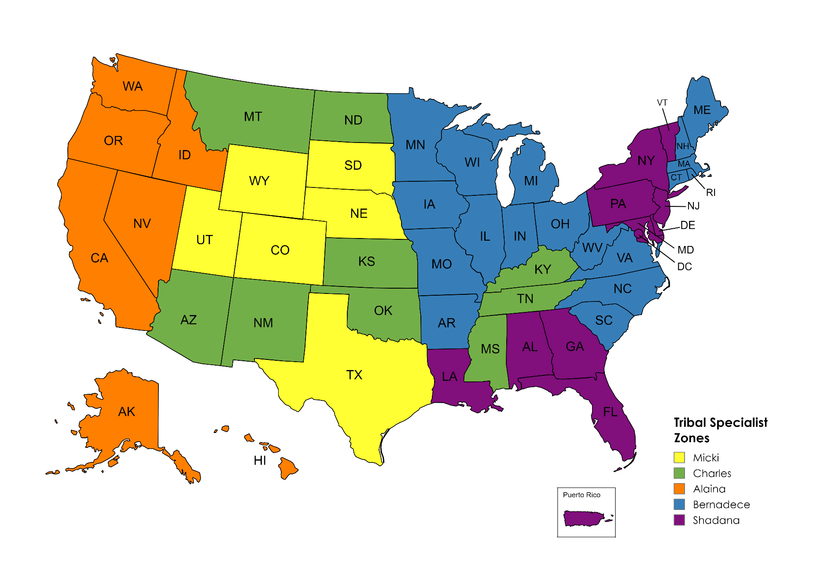
Tribal Relations Overview
Tribal Data Tabulation
Engage Partners
Updates and resources for ongoing surveys
Surveys & Upcoming 2030 Census
Geographic Programs
Cultural Awareness and Engagement
Field and other Directorates
Notes:
The U.S. Census Bureau recognizes Tribal Sovereignty, we acknowledge the gov-to-gov relationship as an extension of the federal trust responsibility. TRP made permanent in 2021, there are four TRS’s and one Coordinator.
New program focused on providing ongoing support to Indian Country during nonDecennial years
Here are examples of work we do and coverage zones: I work in the orange states.

Slide 3

Tribal Data Tabulation
Geography
  Where people live, not Enrollment.
  Tribal Land and Urban counts
Race/Ethnicity
  Self-identification
  AIAN Category
Notes:
If you think about it, a large part of our work is putting data on a map.
Therefore, our focus is where people live, not enrollment.
There are 574 Federally Recognized Tribal Nations and 60+ State recognized Tribes. If we have access we count on reservations and off-reservation trust lands.
The bureau follows the federal guidelines on Race and Ethnicity. (SPD 15) Updated 3/28/24

Slide 4
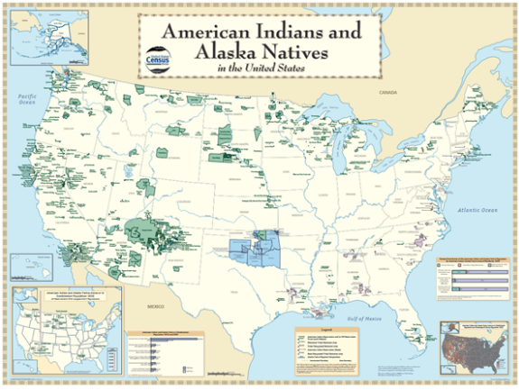
Tribal Geography: AIAN Areas
  Reservations (AIR's)
  Trust Lands
  Oklahoma Tribal Statistical Areas (OTSA's)
  Tribal Subdivisions
  Census Designated Places (CDP’s)
  Tribal Designated Statistical Areas
https://www2.census.gov/geo/pdfs/reference/geodiagram.pdf

Slide 5

2020 Census Detailed Demographic and Housing Characteristics File A (Detailed DHC-A)
1,500 detailed racial and ethnic groups
  Tribal Groupings vs Tribal Affiliation
Amount of data available depends on population size within a specific geography
  As much detail as possible while ensuring strong confidentiality protections.
Mapping capabilities with heat sensor
Notes:
The 2020 Census Detailed Demographic and Housing Characteristics File A (Detailed DHC-A) includes detailed data tables on the following:
Subjects: Population counts and sex-by-age statistics for approximately 1,500 detailed racial and ethnic groups, such as German, Lebanese, Jamaican, Chinese, Native Hawaiian, and Mexican, as well as American Indian and Alaska Native (AIAN) tribes and villages like the Navajo Nation.
Geographies: Nation, state, county, places (cities and towns), census tracts, and American Indian/Alaska Native/Native Hawaiian (AIANNH) areas.
The amount of data available for the detailed racial and ethnic groups and AIAN tribes and villages depends on their population size within a specific geography. This approach allows the Census Bureau to produce as much detail as possible while ensuring strong confidentiality protections.

Slide 6
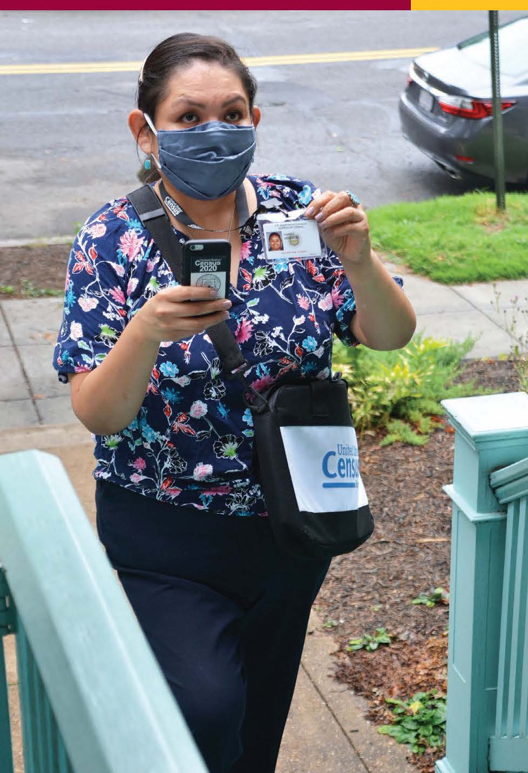
Ongoing Surveys
130+ Surveys each year
  American Community Survey (ACS)
  Household Pulse Survey
  Current Population Survey
  Economic Survey (Business Focus)
  Boundary Annexation Survey (BAS)
Census is Hiring: New Online Application process!
https://www.census.gov/about/census-careers.html
https://www.census.gov/programs-surveys/surveys-programs.html
Notes:
*Keep in mind Econ Survey is for businesses, either individually owned or tribally owned (annually, monthly, qtrly)

Slide 7
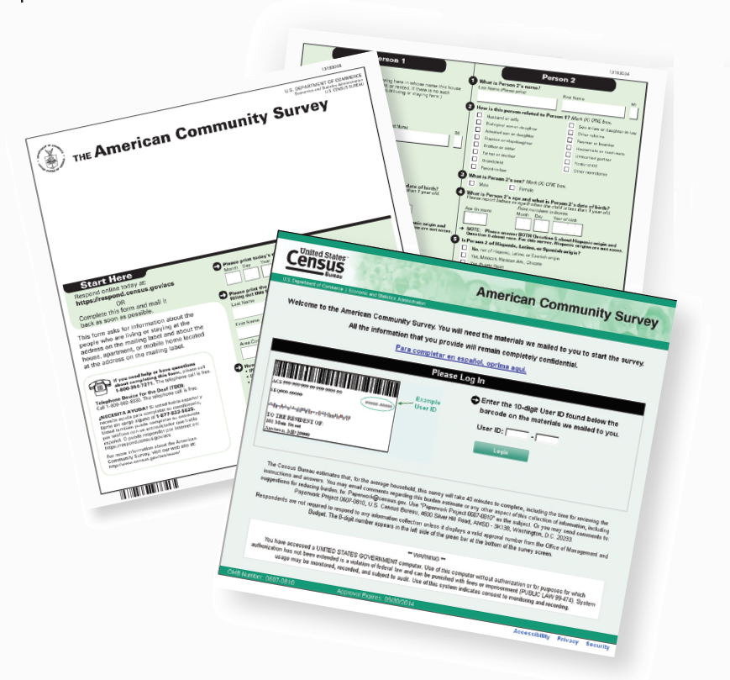
American Community Survey (ACS)
Features
3.5 million addresses
Trillion Federal Spending
40 topics
300+ evidence-based Federal government uses
11 billion estimates each year
Three key annual data releases:
  1-year Estimates (65K+ Population)
  1-year Supplemental Estimates (20K+ Population)
  5-year Estimates (all areas)

Slide 8
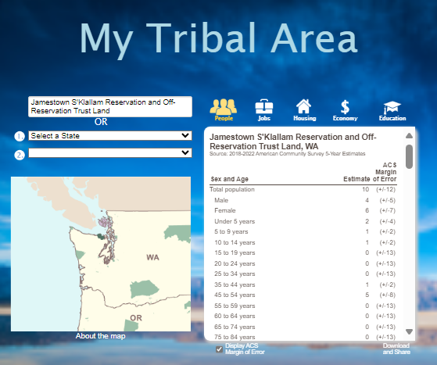
My Tribal Area
Demographic, social, economic, and housing Stats (ACS)
AIAN Lands (not Urban)
Community Planners
Grant Writers
Tribal Officers/Directors
Partners to Tribal Nations

Slide 9

Explore Census Data
Census Academy
Data Gems
Courses
Webinars
Individual Training
Armando Mendoza
Data Dissemination Specialist
armando.mendoza@census.gov
818.554.3606

Slide 10

Questions?
SiokWil
Alaina Capoeman (Quinault)
Tribal Relations Specialist
alaina.j.capoeman@census.gov
818.319.7437

