Slide 1
Boundary and Annexation Survey
Victoria Montgomery
Geographer, U.S. Census Bureau

Slide 2
Agenda
Overview
Tribes and Tribal Geography Mapping
History of Tribal Geography Updates
Census Bureau and the Bureau of Indian Affairs
Tribal Geography Areas
Tribal Boundary and Annexation Survey (BAS)
What is TBAS?
Benefits of Participation
Annual Response
Submission Methods

Slide 3
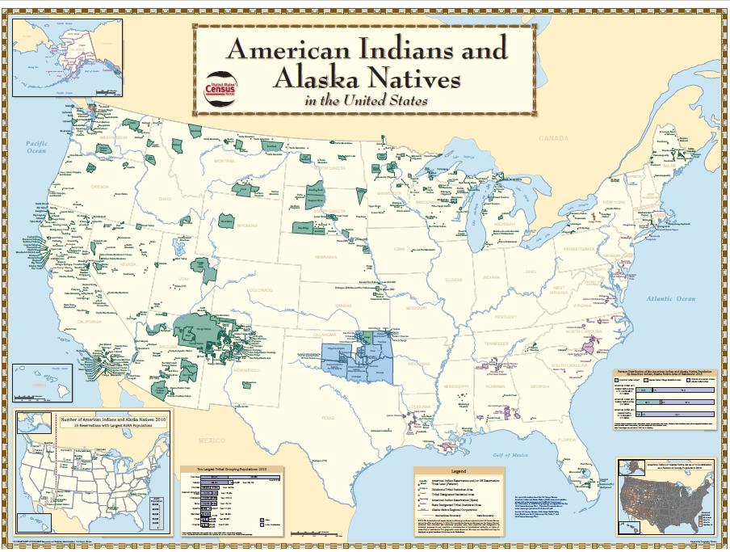
Tribes and Tribal Geography - Mapping
The geography of a tribal nation is defined in many ways by both the federal government and tribal representatives.
Census Bureau shapefiles depict official geographic areas, not tribes or tribal governments.

Slide 4
Recent History with Tribal Boundaries
1980s: The Census Bureau developed the Topologically Integrated Geographic Encoding and Referencing database (TIGER) as an early geographic information system (GIS).
1989: The Census Bureau laid the foundation of tribal geographies in TIGER.
Federally recognized tribes were asked to review the maps and send corrections.
The corrected maps were given to the Bureau of Indian Affairs (BIA) to certify.
Certified maps were ingested into TIGER to lay the foundation of tribal geography.
1990: TIGER was first used in a decennial census.
Late 1990s to present: Federally recognized tribes are included in the annual Boundary and Annexation Survey (BAS).

Slide 5
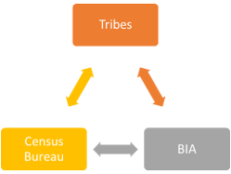
Census Bureau and the BIA
Formalized relationship with various Memorandum of Understanding (MOU)s
A renewed MOU is currently in review.
BIA annually publishes the list of federally recognized tribes.
BAS relies on BIA legal documentation for authorizing/recognizing reservations and lands taken into trust.
Due to the Census Bureau’s commitment to a government-to-government relationship with tribes, BAS does not ingest BIA data directly without receiving tribal input or authorization.

Slide 6
Tribal Geography in the TIGER/Line Shapefiles
 | Updated in Tribal BAS | Updated in Participant Statistical Areas Program (PSAP)
Associated with Federally Recognized Tribes | Federally Recognized Reservations Federally Recognized Off-Reservation Trust Land Federal Tribal Subdivisions | Tribal Tracts and Block Groups Tribal Designated Statistical Areas (TDSAs) Oklahoma Tribal Statistical Areas (OTSAs) OTSA Tribal Subdivisions Alaska Native Village Statistical Areas (ANVSAs)
Associated with States | Hawaiian Home Lands | State Reservations Alaska Native Regional Corporations (ANRCs) State Designated Tribal Statistical Areas (SDTSAs)

Slide 7
American Indian Reservations
Boundaries established or defined by treaty, statute, and/or executive or court order.
Area set aside by the federal government or a state government for the sovereign use of a particular tribe or tribes.
Since allotment, reservations no longer necessarily match land ownership.
On-reservation trust lands are not distinguished from other reservation land types in Census Bureau products.

Slide 8
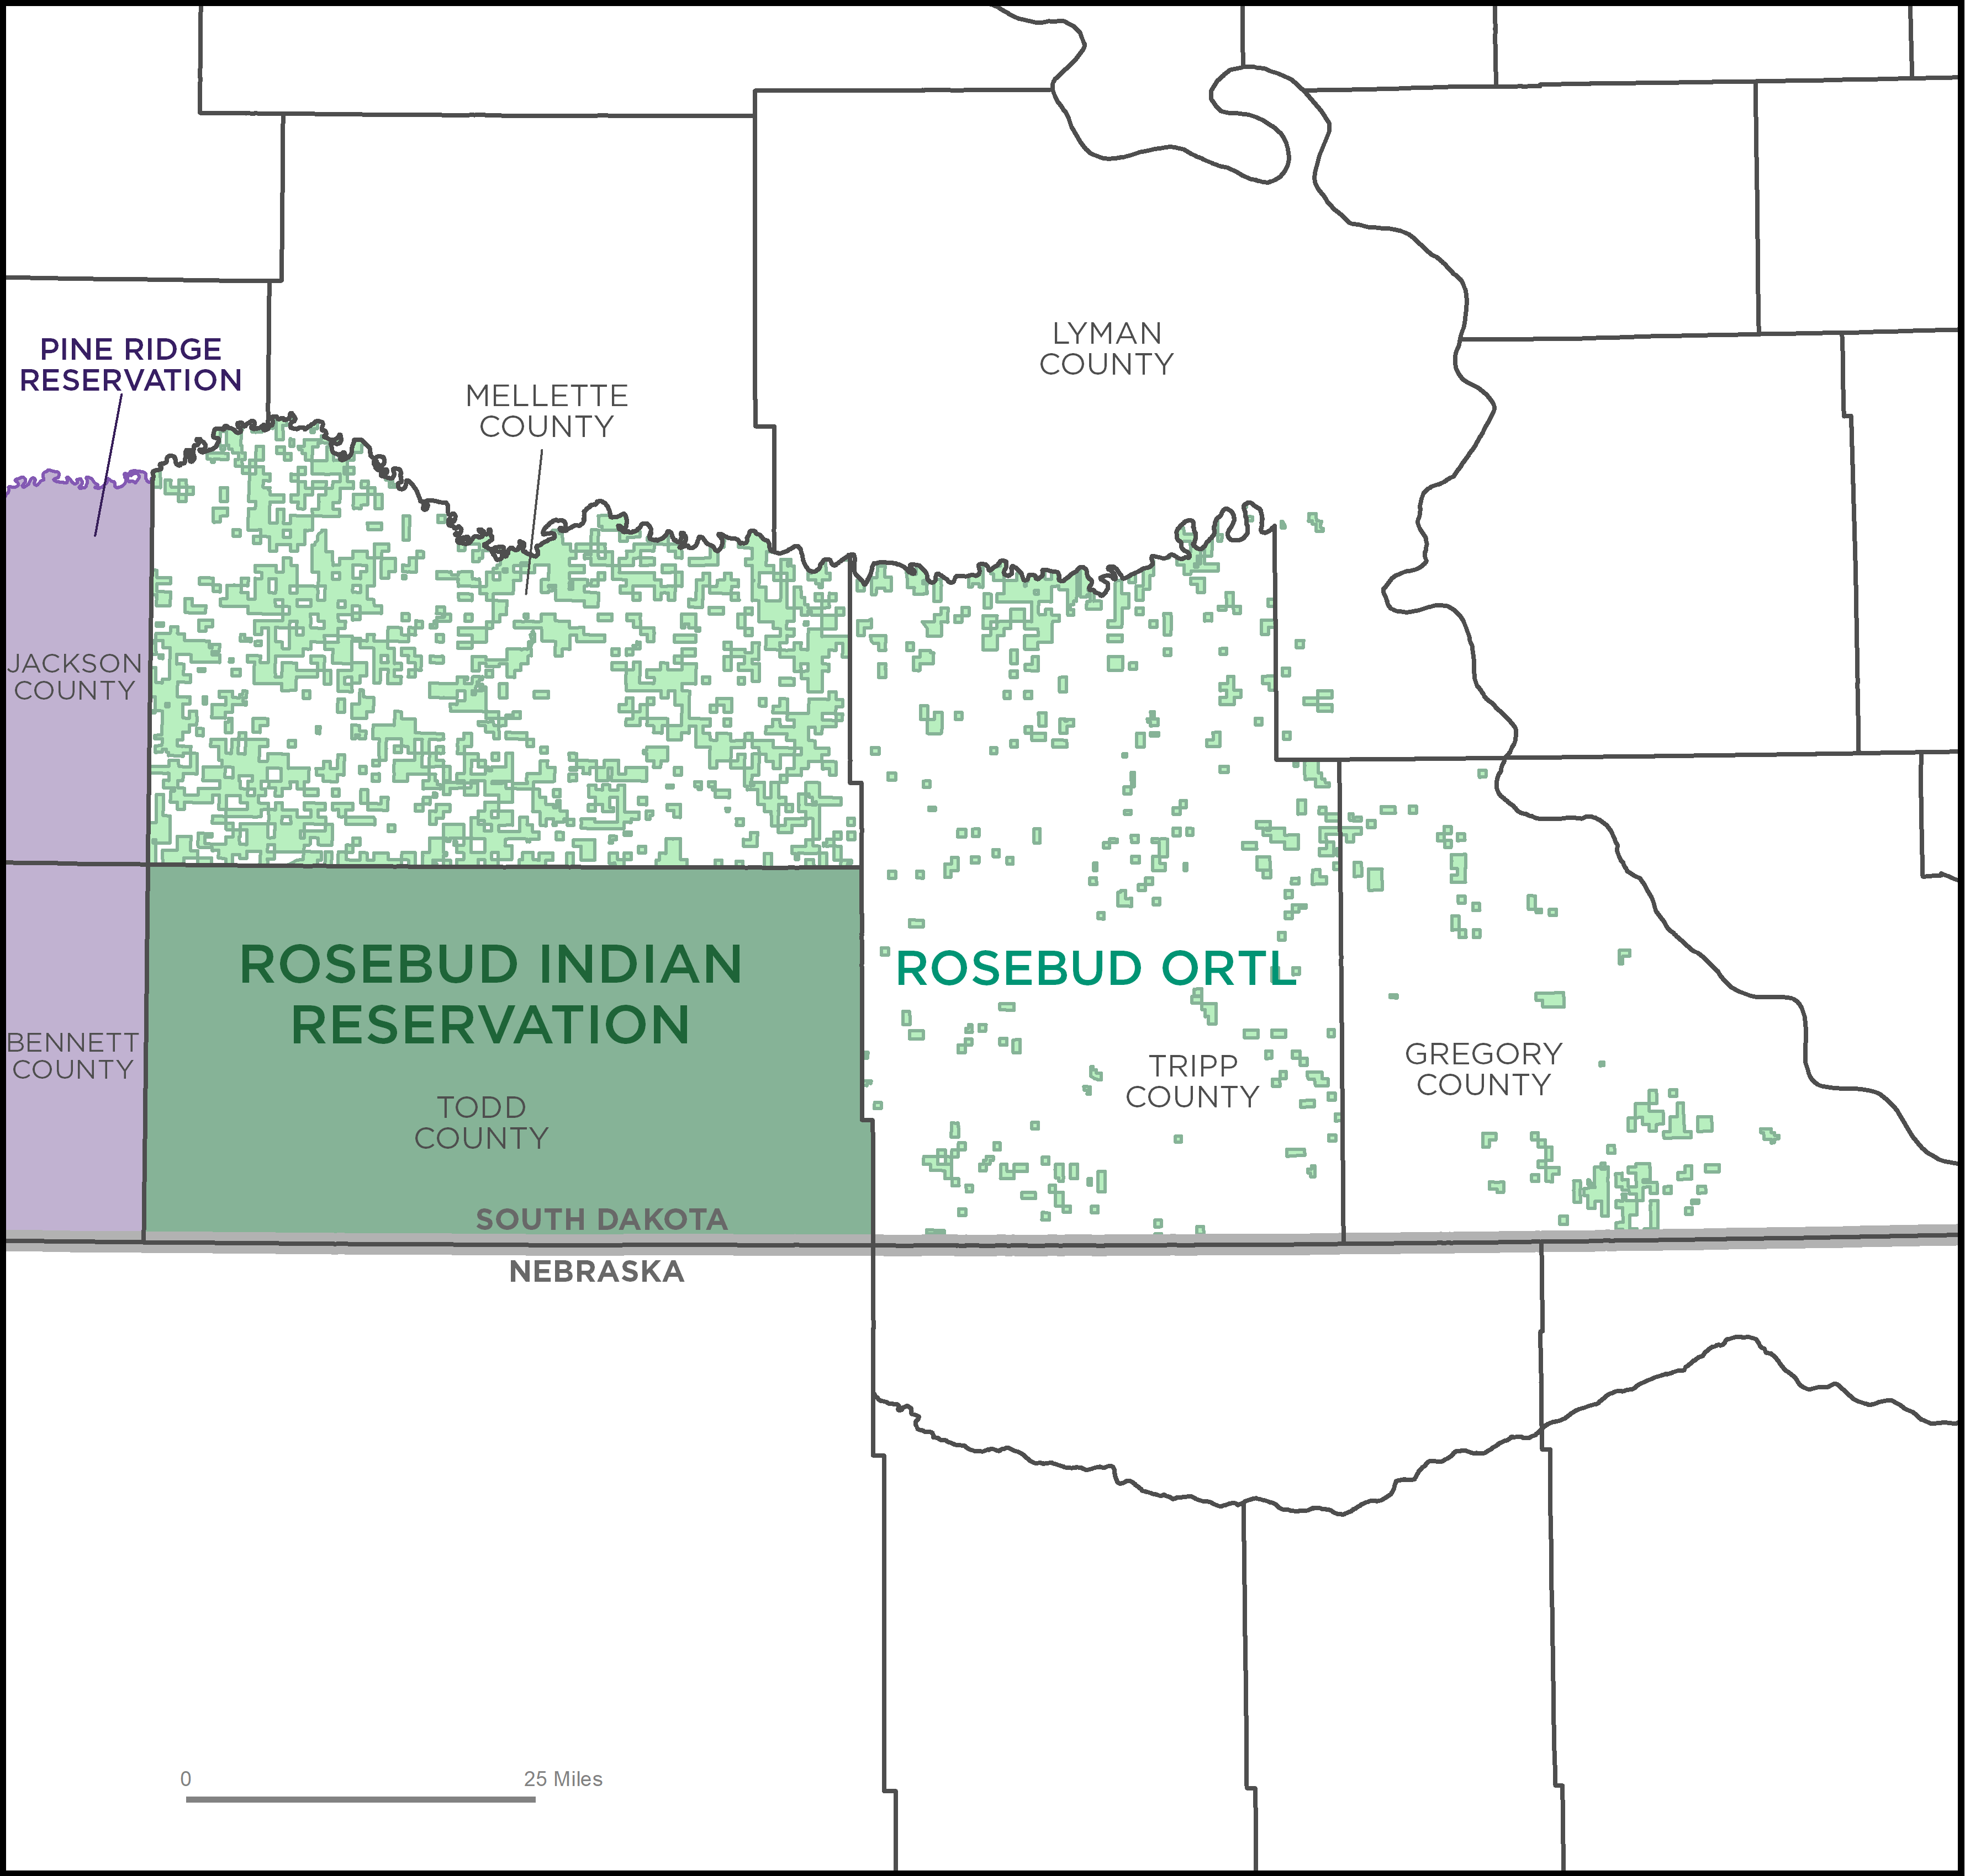
Trust Lands
Parcels of land for which the United States holds the title in trust for the benefit of a tribe or a specific group of tribes.
Includes most tribal or individual tribal member ownership.
Does not include restricted fee lands or fee simple lands.
Individual or tribal ownership.
“On-” or “Off”-reservation.
Surface and/or subsurface rights.

Slide 9
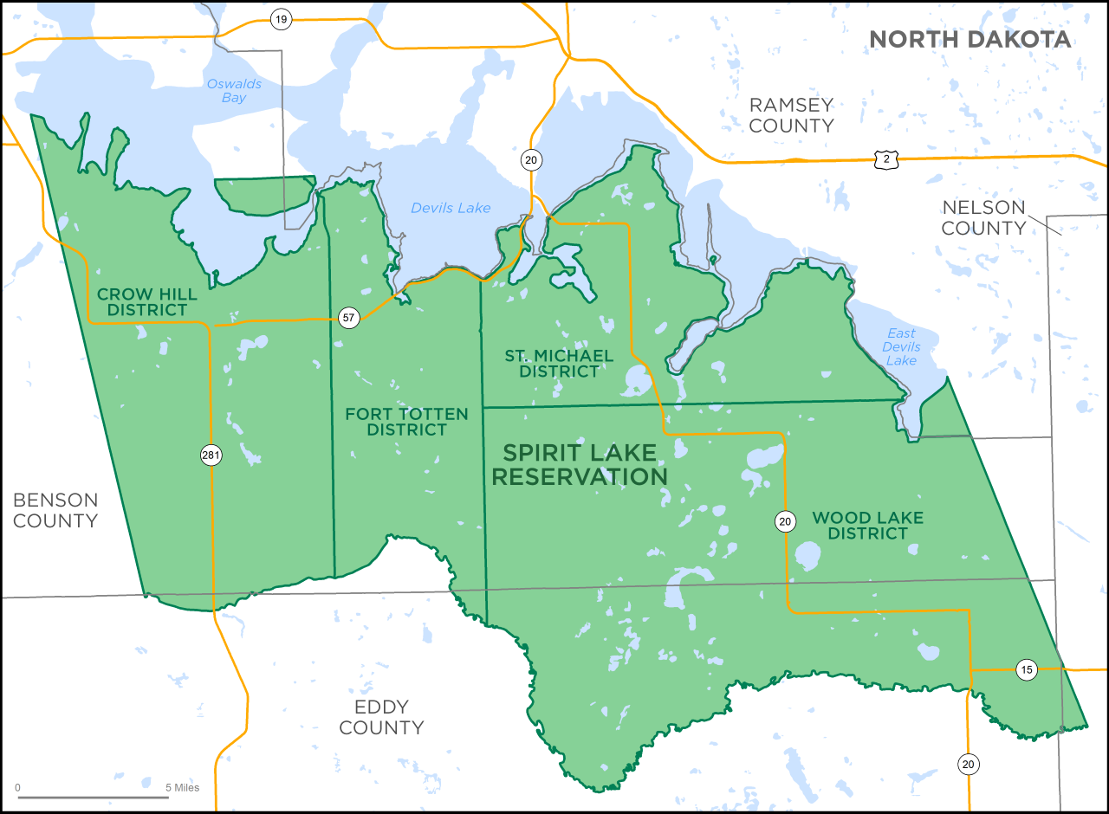
Tribal Subdivisions
Legal administrative subdivisions of federally recognized reservations and off-reservation trust lands.
Not all federal reservations have tribal subdivisions.
Can only exist on the reservation and off-reservation trust land; but do not always cover the entire reservation and trust land.

Slide 10
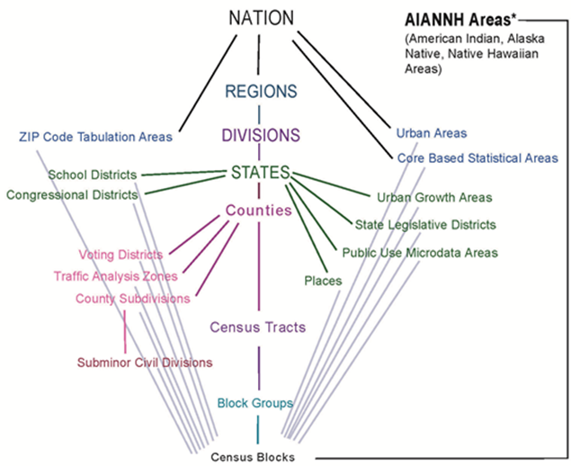
Geographic Relationships
Tribal geography is unique in how it relates to other geographies.

Slide 11
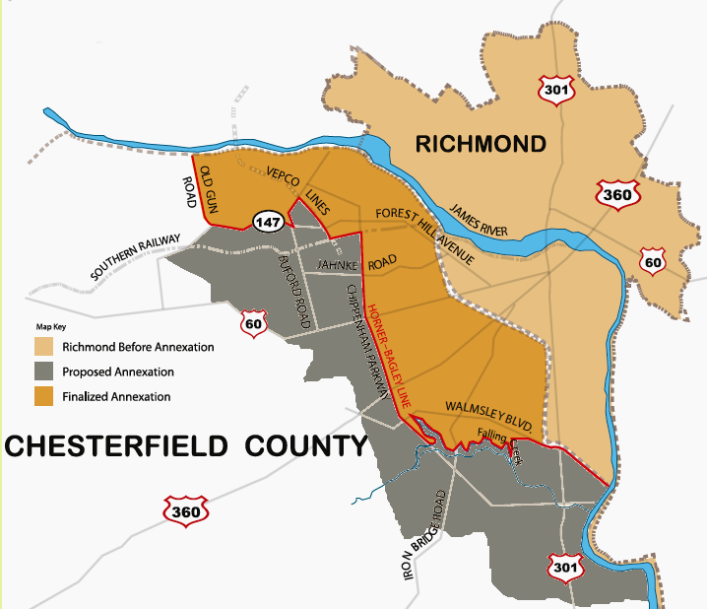
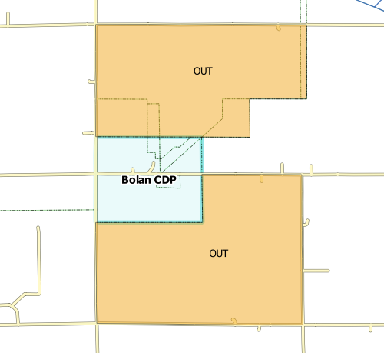
Tribal Boundary and Annexation Survey (TBAS)
Annual opportunity for tribal, state, and local governments to submit:
Shafter Flats
Honolulu Makai
Boundary changes
(de/annexations, corrections)
Name or description changes
Status updates
(new reservation or trust status, dis/incorporations, mergers, consolidations,)
Updates to Census Designated Places (CDPs)

Slide 12
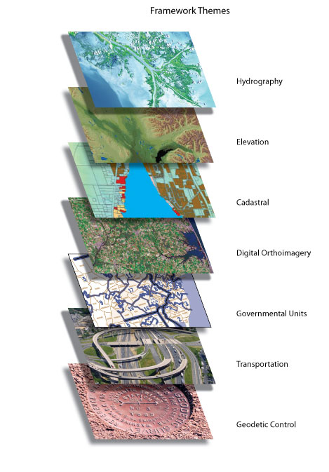
Purpose of BAS
To support the mission of the Census Bureau and provide meaningful statistical data for the tribal governments, other federal agencies and data users.
Cultural and Demographic Statistics: Department of Commerce, U.S. Census Bureau
“These geospatially referenced data describe the characteristics of people, the nature of the structures in which they live and work, the economic and other activities they pursue, the facilities they use to support their health, recreational and other needs, the environmental consequences of their presence, and the boundaries, names and numeric codes of geographic entities used to report the information collected.”
-Office of Management & Budget (OMB) Circular A-16
National Spatial Data Infrastructure

Slide 13
Benefits of Participation
Participating in BAS:
Confirms legal boundaries are current and accurate
Provides the foundation for informed decision making
Ensures communities receive appropriate federal funding
FEDERAL GOVERNMENT

Slide 14
Geographies Eligible for Tribal BAS
Federally Recognized Reservations
Tribal Subdivisions
Federally Recognized Off-Reservation Trust Land
Hawaiian Home Lands
Census Designated Places (CDPs)

Slide 15
Geographies Not Eligible for Tribal BAS
The Census Bureau does not collect or maintain boundaries for:
Allotted Lands.
Restricted Status or Restricted Fee.
Fee Lands.
Service Areas.
Subsurface Rights.
Legal Disputes.

Slide 16
BAS Timeline
January 1st
March 1st deadline
BAS Benchmark
May 31st deadline
Kickoff
ACS benchmark
Changes submitted must be effective as of this date.
Mid-January mailout to BAS Contacts and Highest Elected Officials and Tribal Chairs. Participants can begin to review their boundaries and prepare updates.
Non-Response Follow up
Calls to participants with no response as of March 1st.
Internal deadline for GEO to provide geography for ACS Products.
Internal deadline for GEO to provide geography for next year’s BAS products.
Boundary updates submitted by this date will be reflected in the American Community Survey and Population Estimates Program data, and in next year’s BAS materials.
Boundary updates submitted by this date will be reflected in next year’s BAS materials.

Slide 17
Annual Response Email
Census Bureau sends to all eligible governments in early January.
Notifies governments of upcoming BAS cycle.
Provides a link to the Annual Response Form.

Slide 18
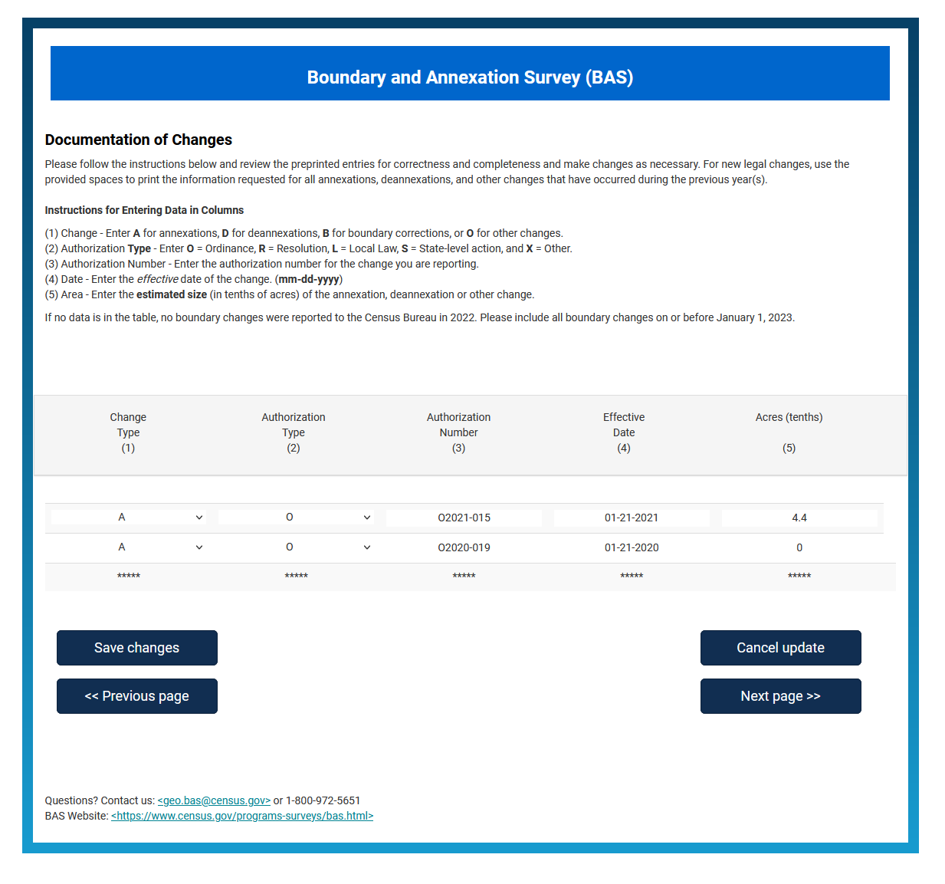
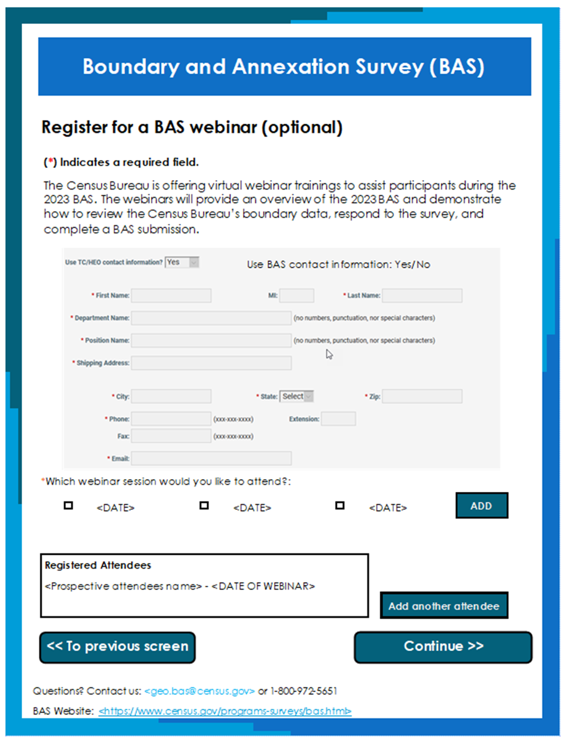
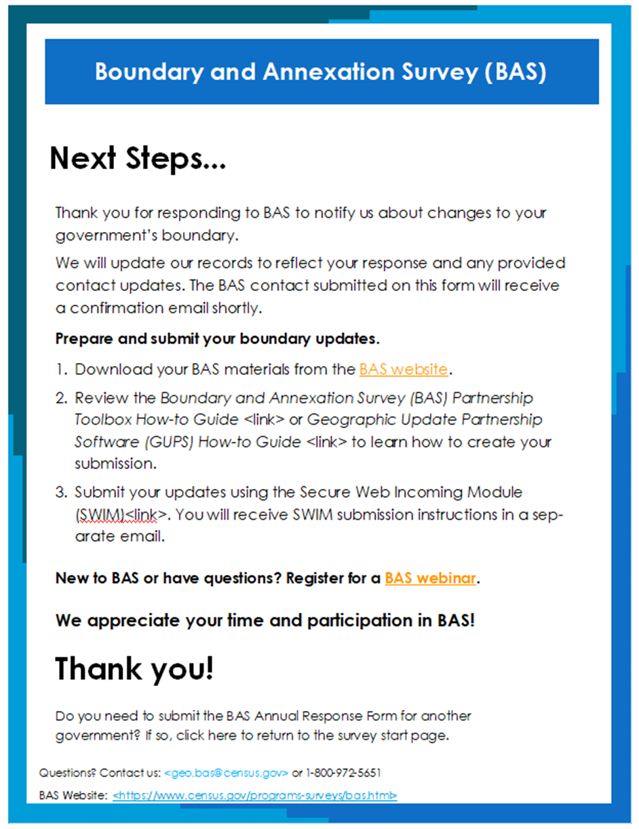
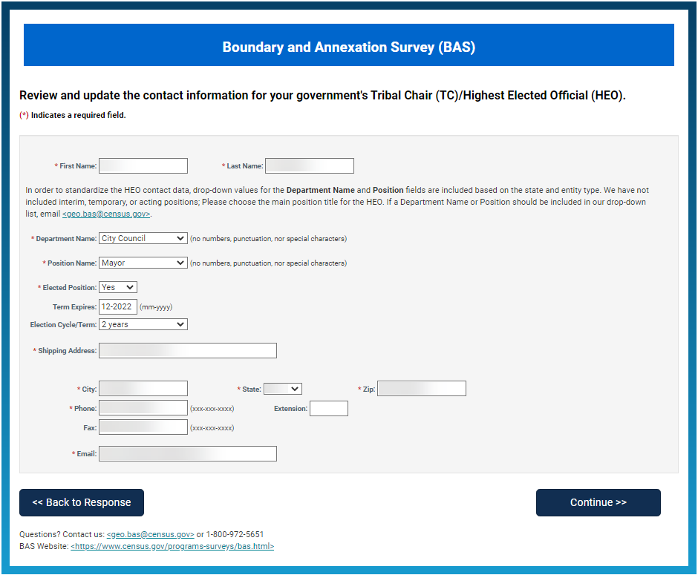
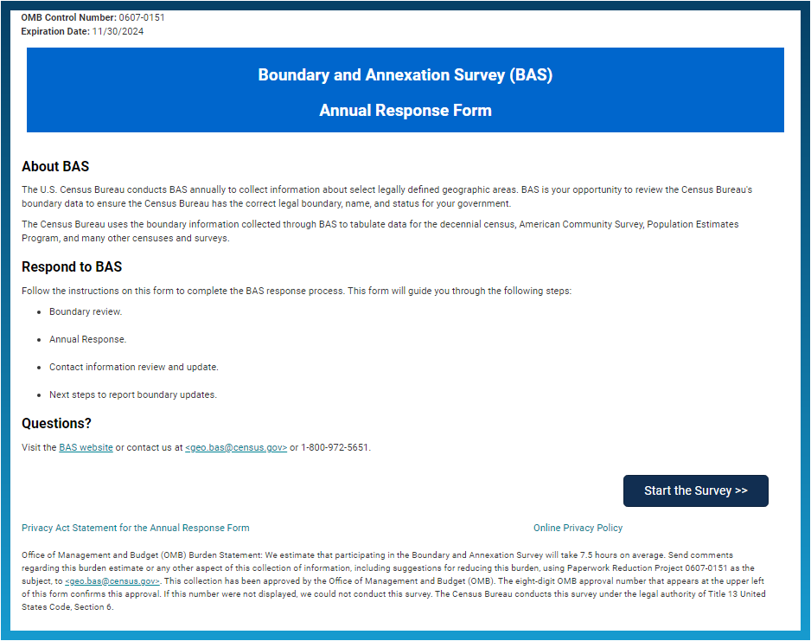
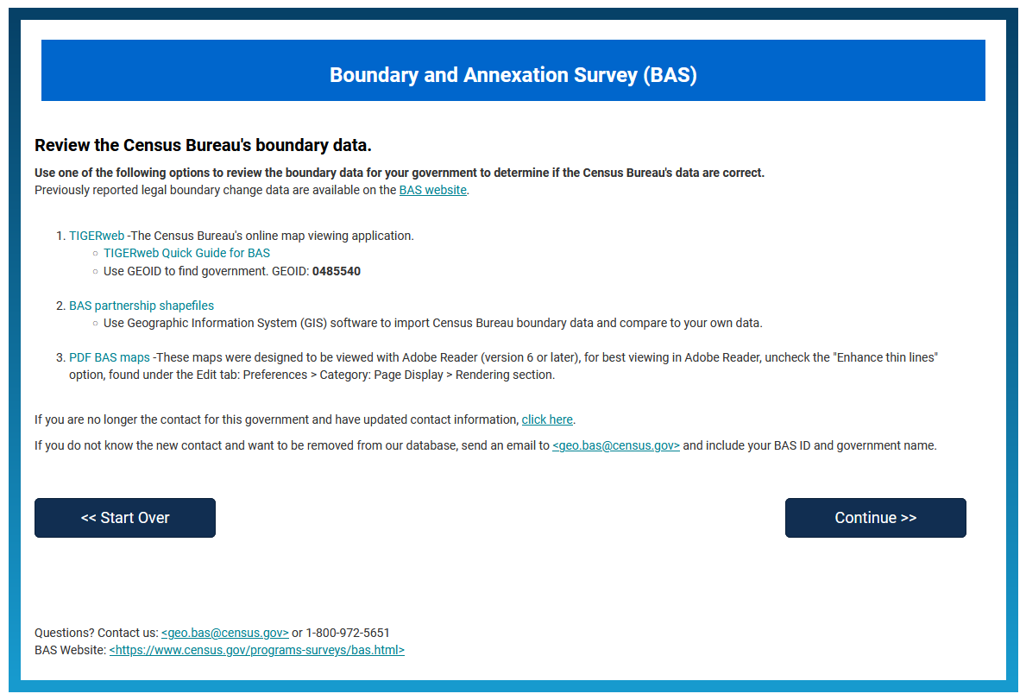
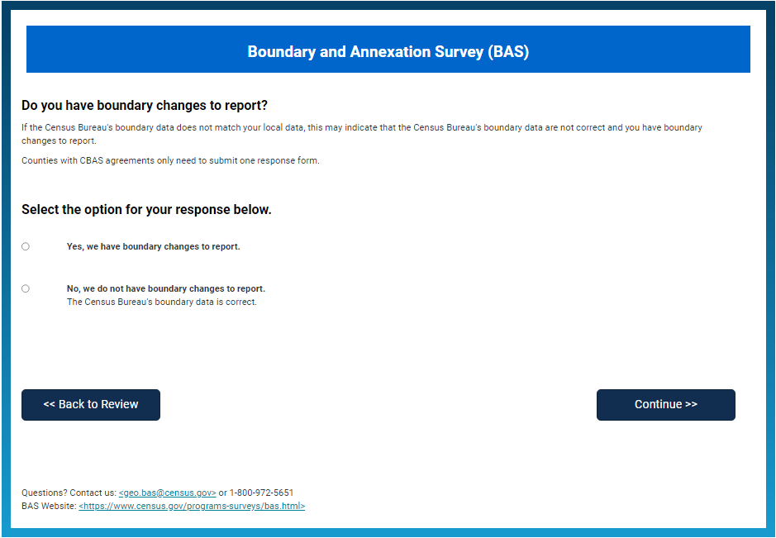
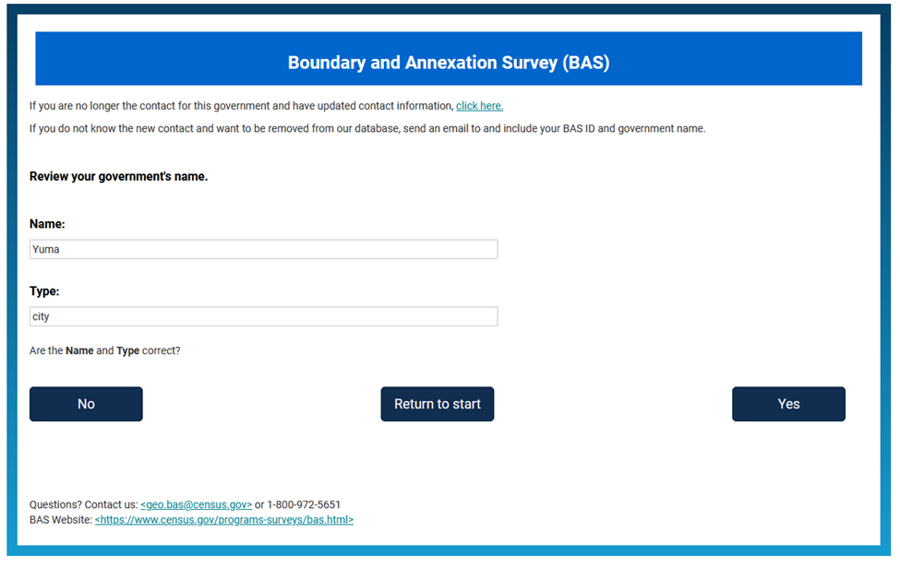
BAS Online Form
Respond to BAS.
Contact Updates.
Automatic interactions.
Multiple submissions allowed.
Material request changes.
No change responses.

Slide 19
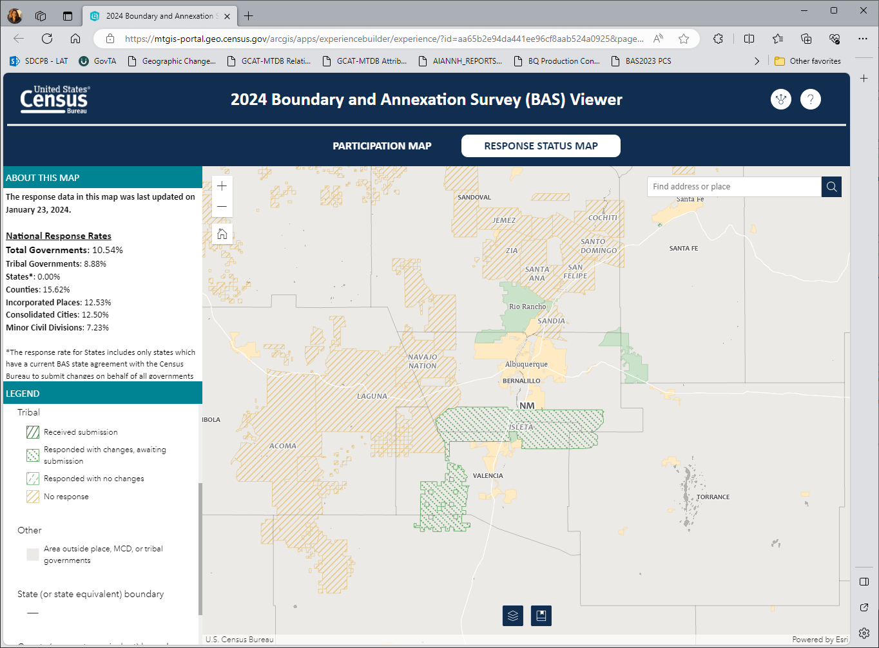
Response Viewer
Transparency, control, and accountability for respondent.
Provides 3 levels of zooming:
State
County
Minor Civil Divisions/Incorporated Place
Tribal Areas
Allows for shareholders to see the status of their counties and partnered governments.

Slide 20
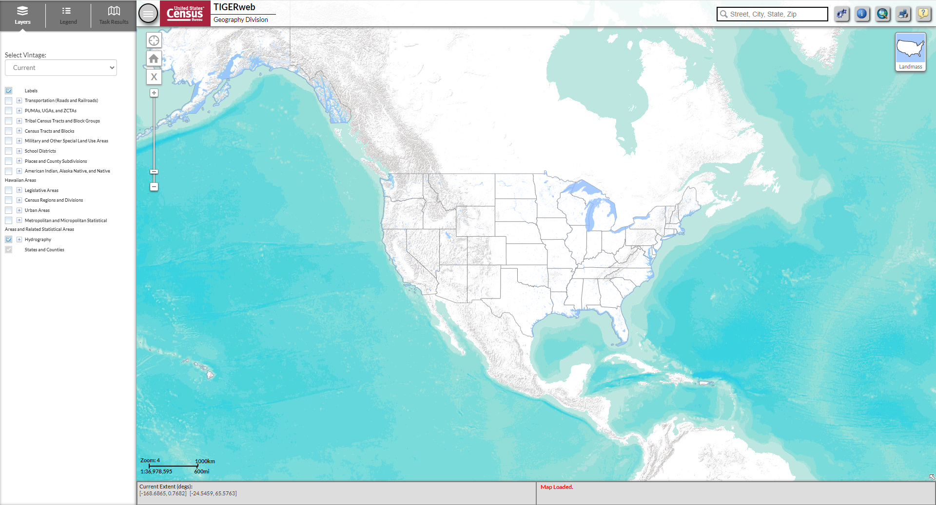
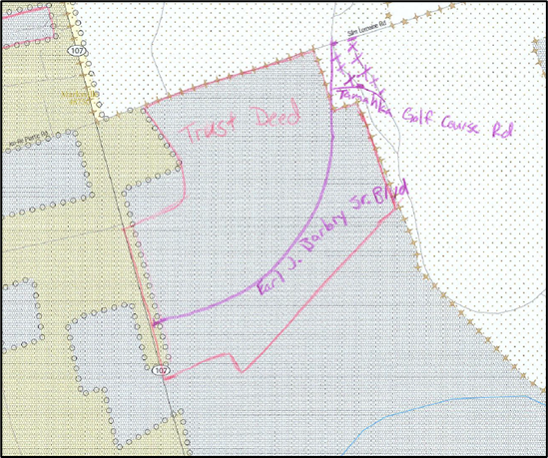
Boundary Review
Methods for reviewing boundaries:
Topologically Integrated Geographic Encoding and Referencing System web viewer (TIGERweb).
BAS partnership shapefiles.
PDF BAS maps.

Slide 21
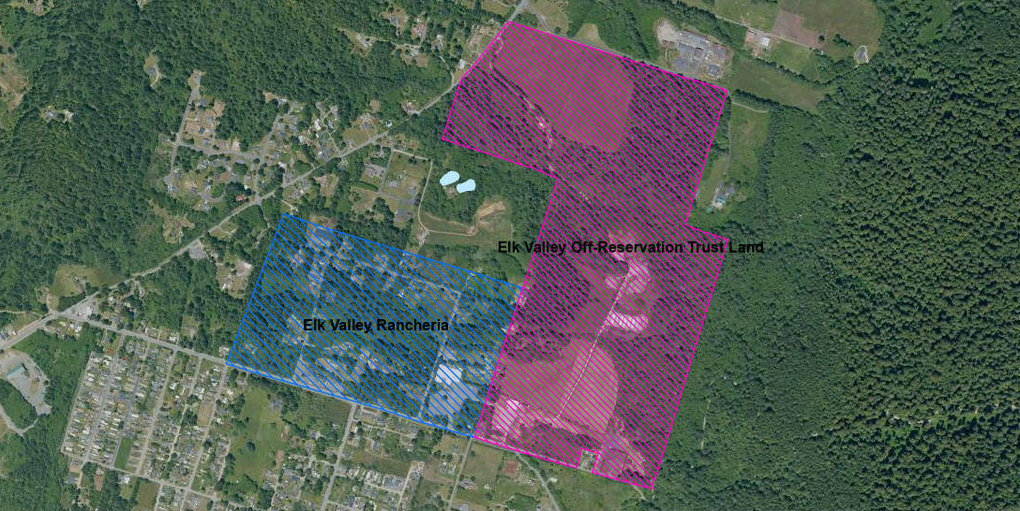
Boundary Review
Elk Valley Off-Reservation Trust Land
Elk Valley Rancheria
Boundary as of 2008
Near Bertsch-Oceanview CDP

Slide 22
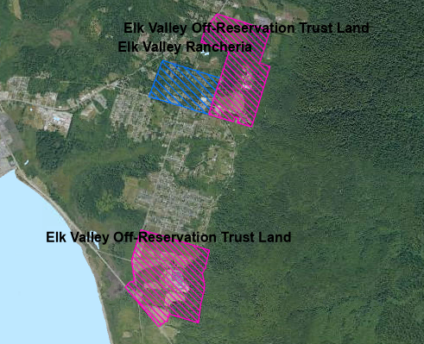
Boundary Review
Elk Valley Off-Reservation Trust Land
Elk Valley Rancheria
Boundary as of 2015
Near Bertsch-Oceanview CDP

Slide 23
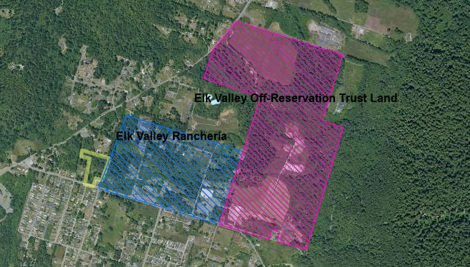
Boundary Review
Elk Valley Off-Reservation Trust Land
Elk Valley Rancheria
New Trust Land Addition
2024 BAS
Near Bertsch-Oceanview CDP

Slide 24
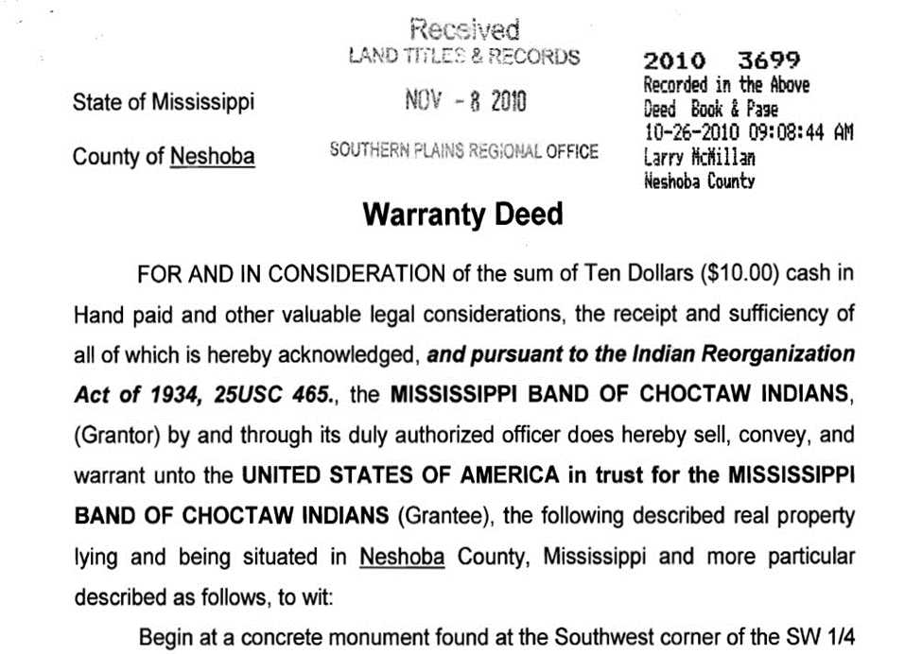
Legal Documentation
Reservation documentation:
Act of Congress.
Executive Order.
BIA Signed letter or document (federal register notice, acceptance of conveyance, title status report, certification etc.).
Reservation Proclamation.
Trust land documentation must include:
“United States of America in trust for x tribe” or that the land is in “trust status.”
Legal description, or parcel numbers.
BIA Seal or Signature.

Slide 25
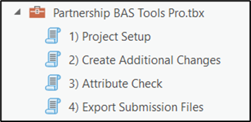
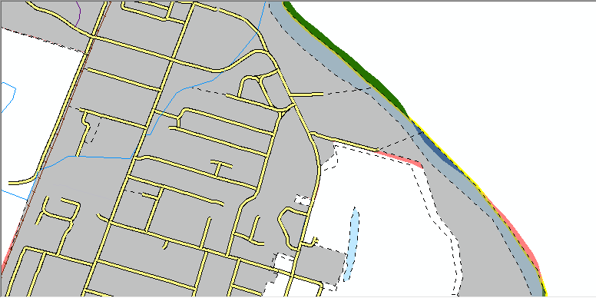
Submission Methods
BAS Partnership Toolbox:
Experienced GIS users.
BAS Partnership toolbox for ArcGIS Pro.
Available for download from the BAS website.
Partnership shapefiles.
Available for download from the BAS website.

Slide 26
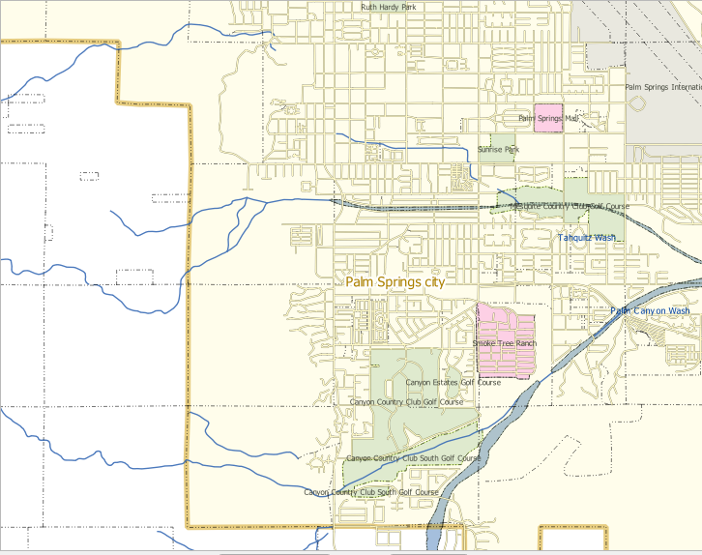
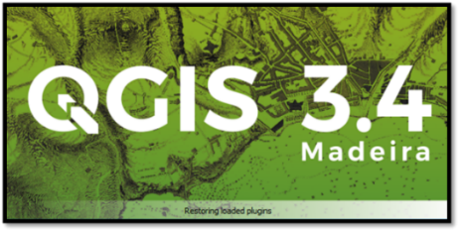
Submission Methods
Geographic Update Partnership Software (GUPS):
Open source QGIS based software.
Basic understanding of GIS.
Available for download from the BAS website.
GUPS Web:
Web-based GIS application.
Automated and manual boundary change creation.

Slide 27
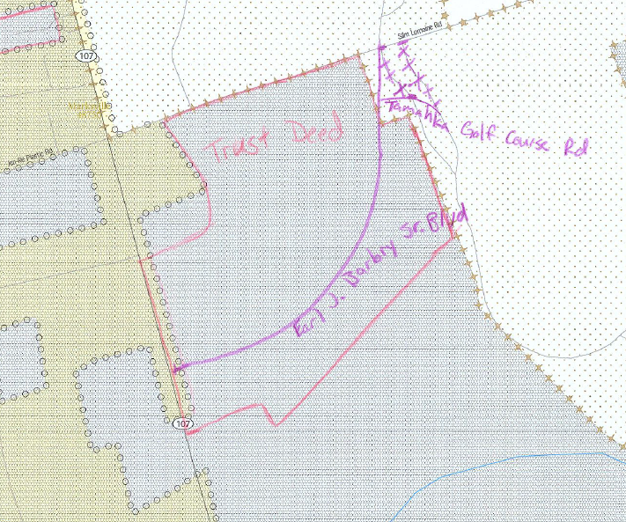
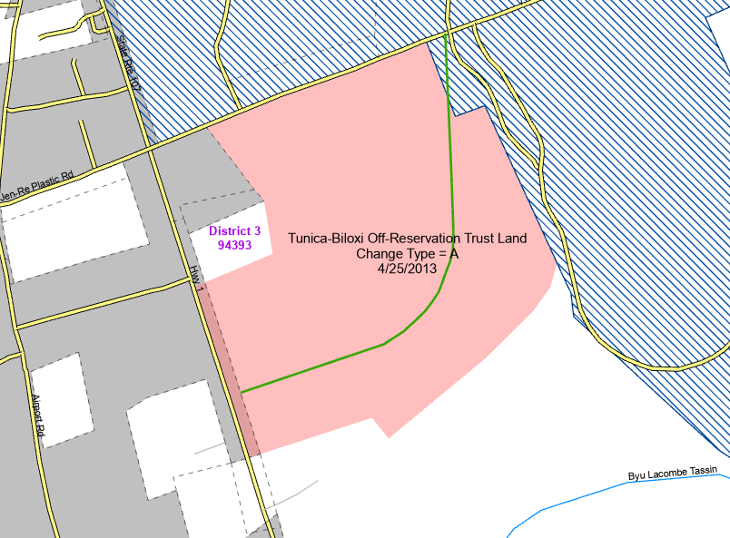
Response Methods
Paper BAS:
No GIS experience required.
Census Bureau mails paper maps upon request.
Participants update maps using the provided annotation materials.

Slide 28
Returning Updates
Digital – Secure Web Incoming Module (SWIM)
Official web portal for uploading materials to the Census Bureau.
Only secure method for submitting digital files to the Census Bureau.
Do not send files through email or File Transfer Protocol (FTP) sites.
Paper – Postage Paid Return Envelope
Return annotated maps using postage paid return envelope provided with materials.

Slide 29
Products
TIGER/Line
BAS Partnership Files
Released in Summer/Autumn
Based on the ACS Benchmark
Can be used to review updates provided by the March 1st deadline.
Released in January
Based on the BAS Benchmark
PVS_23_v2
Used for BAS

Slide 30
Additional Information
BAS Website: https://www.census.gov/programs-surveys/bas.html
Program information.
Program schedule.
How-to guides.
Reference materials.
Events and trainings.

Slide 31
BAS Website and GUPS Web Walkthrough

Slide 32
Questions?
Contact information
Boundary and Annexation Survey (BAS) questions
Phone: 1-800-972-5651
Email: geo.bas@census.gov
Victoria.A.Montgomery@census.gov
812-218-3147

